Slide 1
CSS - Training

Slide 2

Position

Slide 3
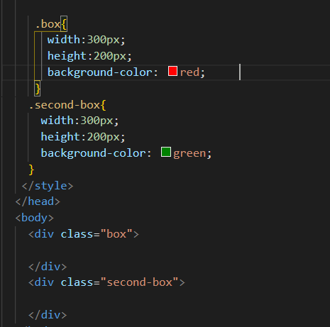

Default Position - static

Slide 4
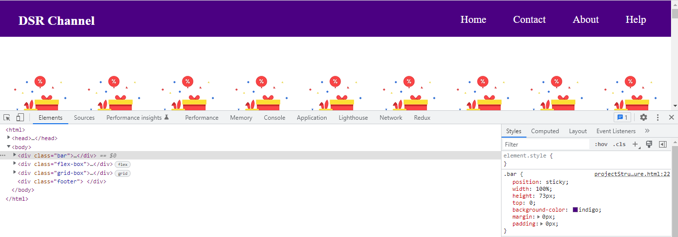
Position:sticky

Slide 5
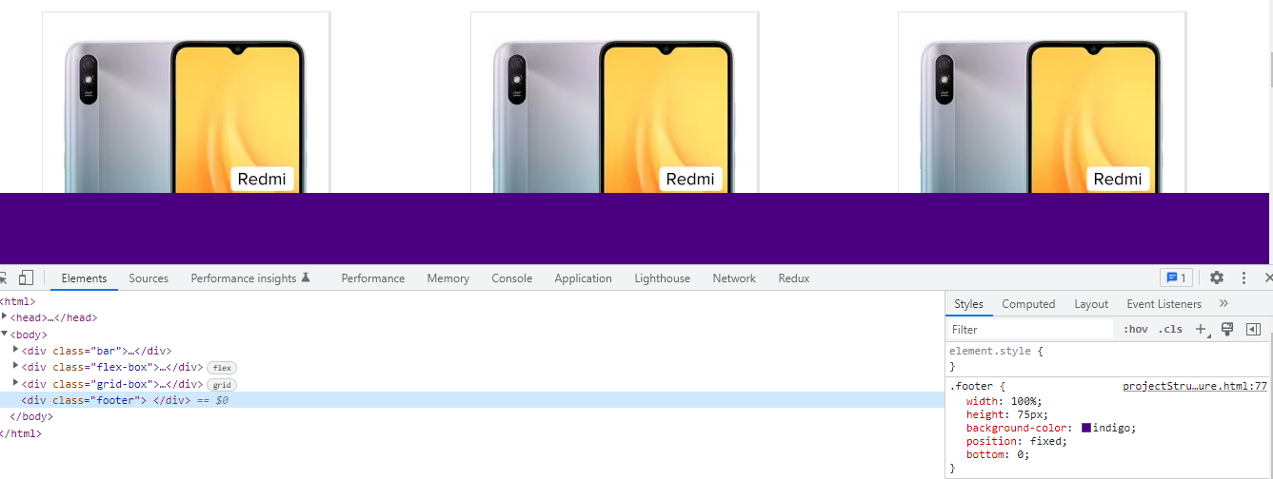
Position:fixed

Slide 6
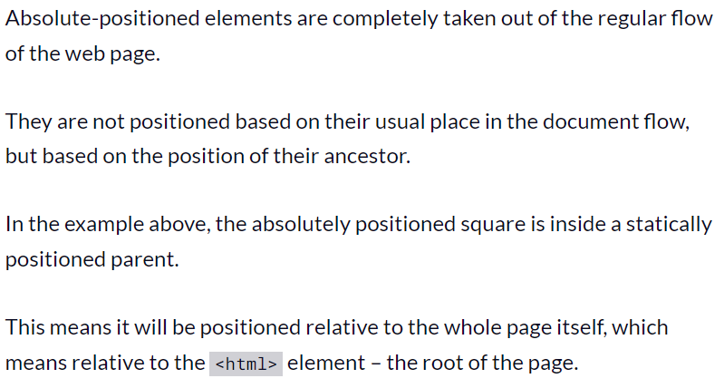
Position:absolute

Slide 7
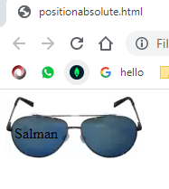
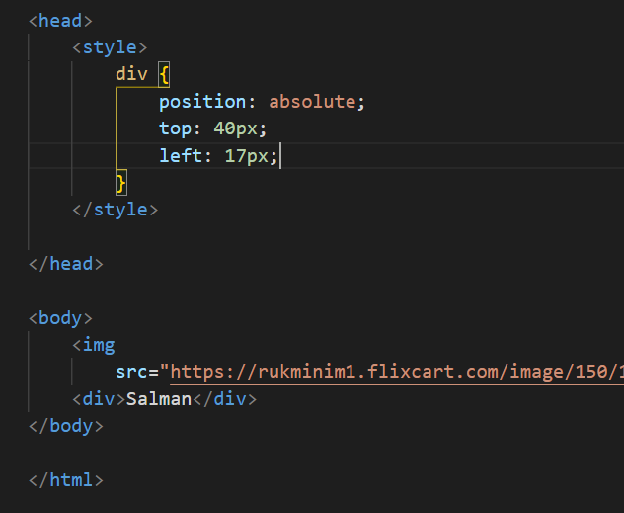
Position absolute

Slide 8
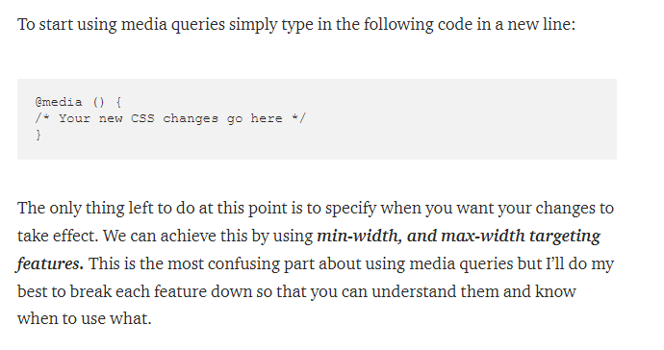
Media Query

Slide 9
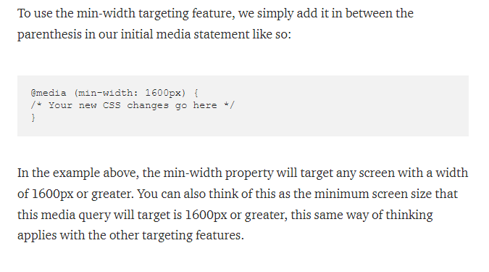
Media query – min-width

Slide 10
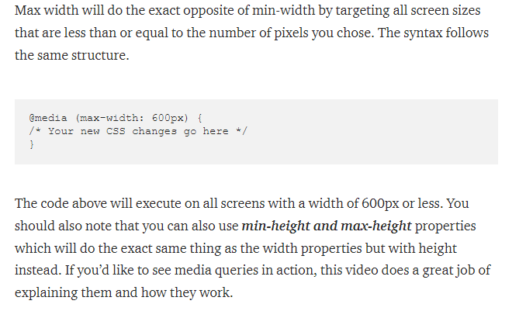
Media query – max-width

Slide 11
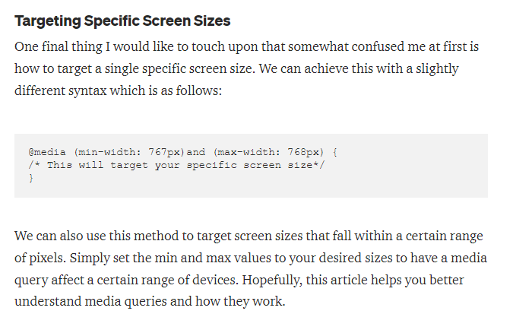
Targeting specific

Slide 12
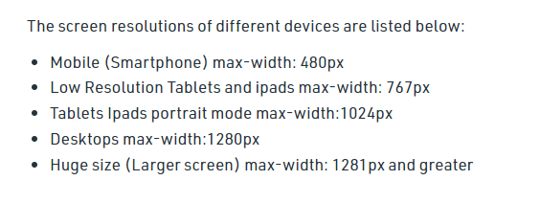
Screen Size Resolution

Slide 13
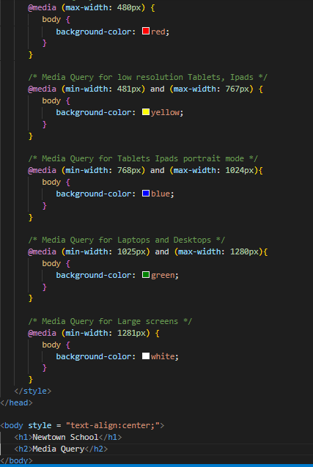

Slide 14
Text Effects
Text-overflow
Word-wrap
Word-break
Writing-mode

Slide 15
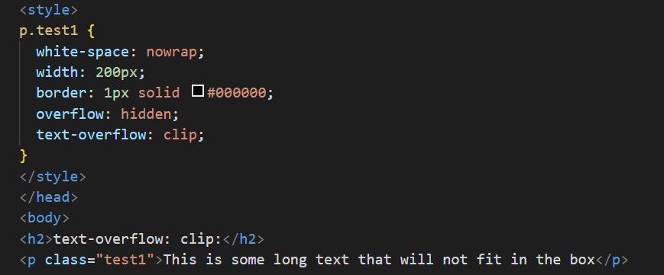

text-overflow:clip

Slide 16
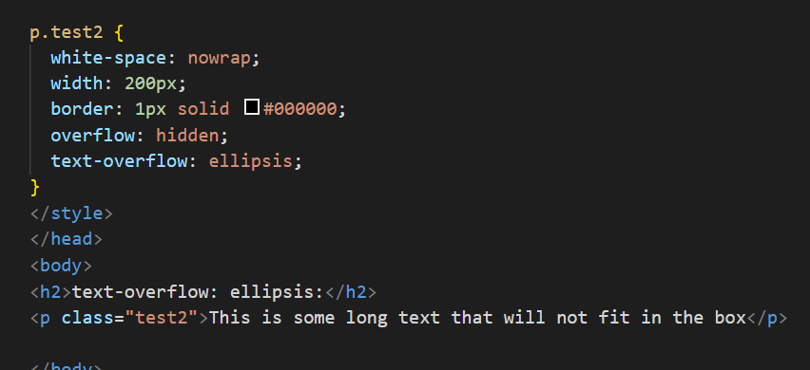
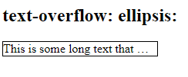
text-overflow:ellipsis

Slide 17
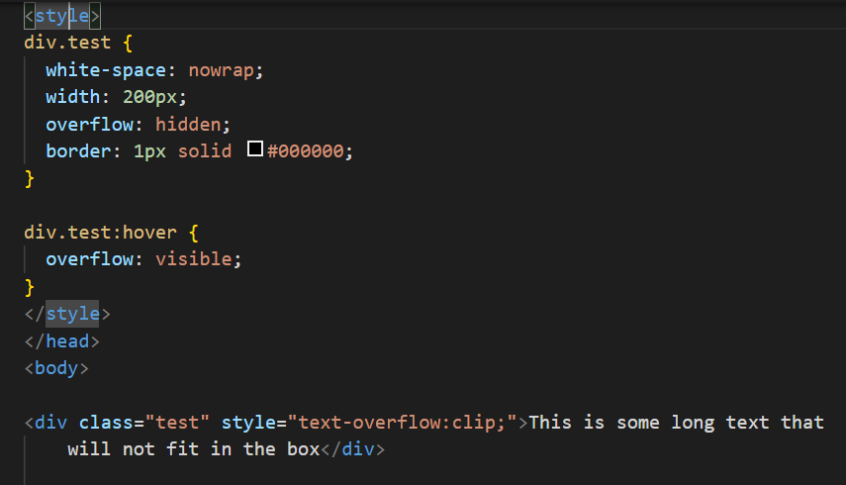

Overflow:visible

Slide 18
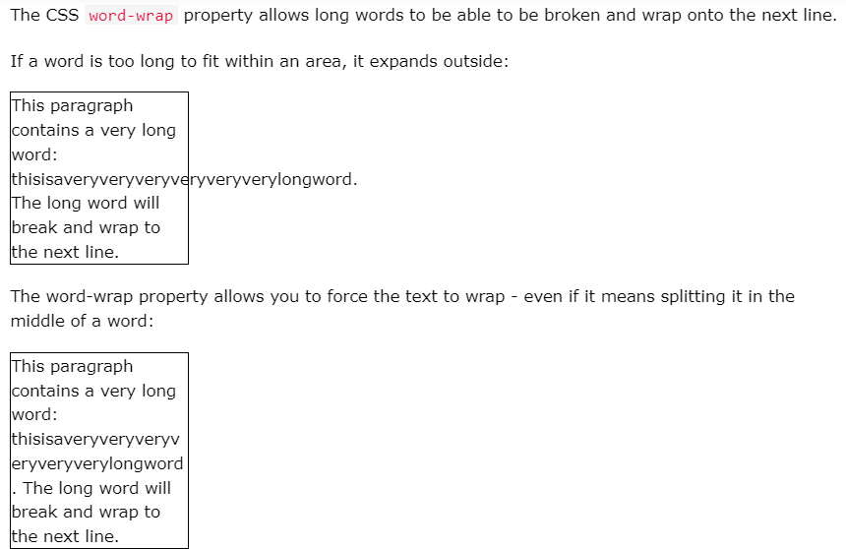
Word-wrap:break-word

Slide 19
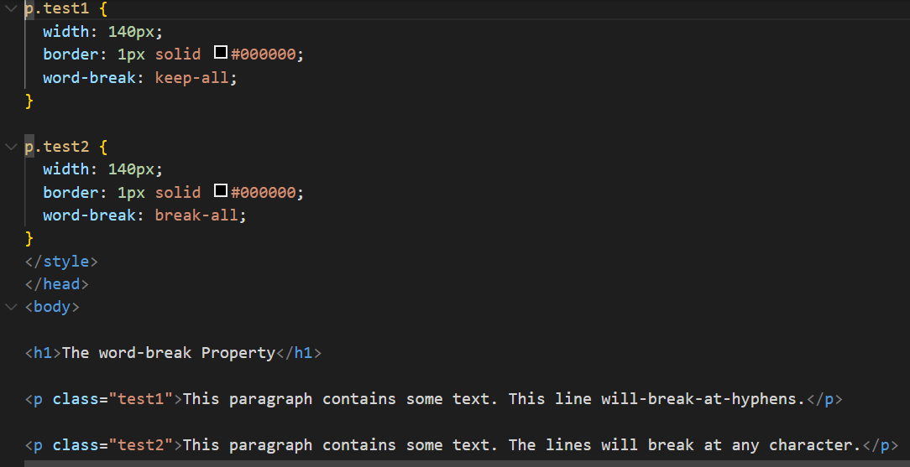
Word-break

Slide 20
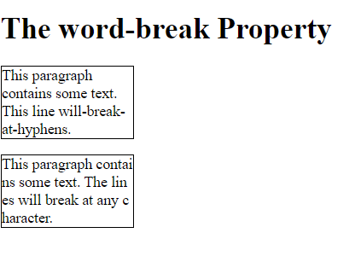
Word-break

Slide 21
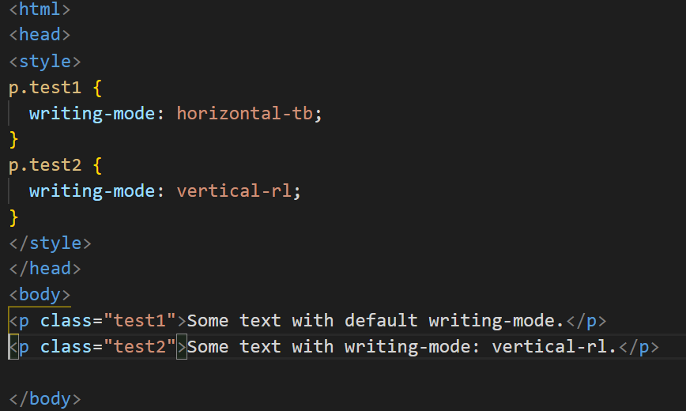
Writing Mode

Slide 22
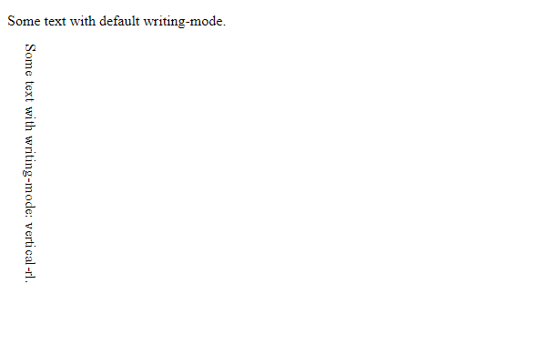
Writing mode - output

Slide 23
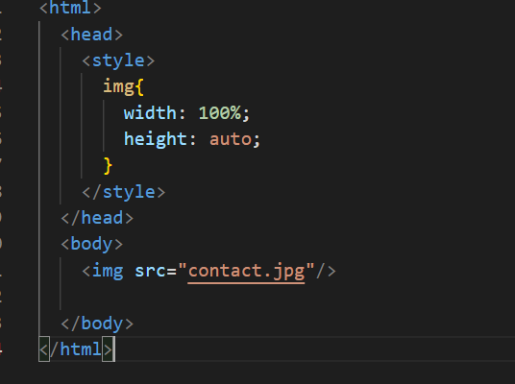
Responsive Image – type 1

Slide 24
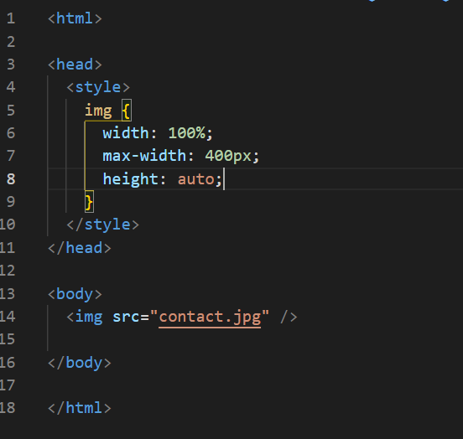
Responsive image – type 2

Slide 25
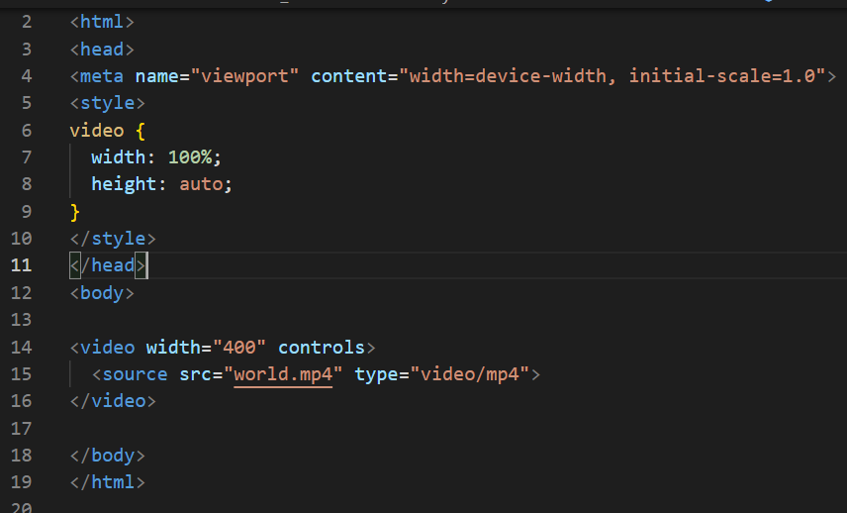
Responsive Video - 1

